Slide 1

SIR SYED UNIVERSITY OF ENGINEERING AND TECHNOLOGY

Slide 2
PRESENTATION TOPIC: RADIX SORT
STUDENT NAME: ZAINAB ARIF: ROLL NUMBER: 2023s-BCYS-028
COURSE: DESIGN ANALYSIS AND ALGORITHM COURSE INSTRUCTOR: MISS AIMAN

Slide 3
Title: Introduction to Radix Sort
Radix Sort is a non-comparative integer sorting algorithm.
It sorts numbers digit by digit, starting from the least significant digit (LSD) or the most significant digit (MSD), depending on the variation.
Each digit is placed in a bucket according to its value.

Slide 4
Example/Working of Radix Sort
Sort following sequence of data using radix sort: 165,958, 635, 694, 480, 637, 598
The largest element in list is 958, and its width is 3. So radix sort
algorithm needs to perform three scans on each digit from LSD to MSD.

Slide 5
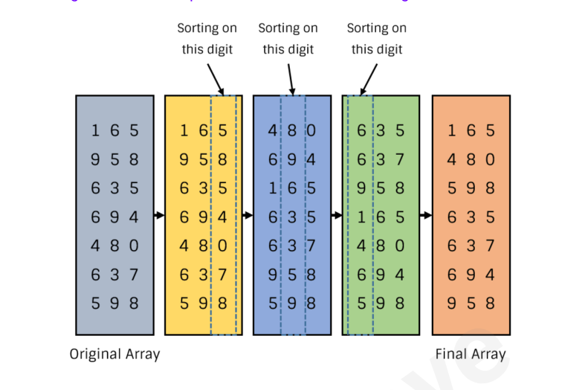

Slide 6
Algorithm of Radix Sort
Step 1: Find the maximum number in the list to determine the number of digits.
Step 2: For each digit (starting from the least significant digit):
Perform counting sort based on that digit.
Step 3: Repeat for all digits, moving from the least significant to the most significant.

Slide 7
Pseudocode of Radix Sort
// Function to perform Radix Sort
void RadixSort(int A[], int n) {
int max = getMax(A, n);
for (int pos = 1; max / pos > 0; pos *= 10) {
CountSort(A, n, pos);
}
}
// Function to perform Count Sort based on the digit at 'pos'
void CountSort(int A[], int n, int pos) {
int count[10] = {0};
int B[n]; // Temporary array to store sorted output

Slide 8
// Count occurrences of each digit
for (int i = 0; i < n; i++)
count[(A[i] / pos) % 10]++;
// Compute cumulative count
for (int i = 1; i < 10; i++)
count[i] += count[i - 1];

Slide 9
// Build the sorted array based on current digit
for (int i = n - 1; i >= 0; i--) {
B[--count[(A[i] / pos) % 10]] = A[i];
}
// Copy sorted elements back into the original array
for (int i = 0; i < n; i++)
A[i] = B[i]; }

Slide 10
Time Complexity of Radix Sort
Time Complexity is O(n*k), where:
n is the number of elements in the input list.
k is the number of digits in the largest number.
If the number of digits is constant, the time complexity becomes O(n).

Slide 11
Space Complexity of Radix Sort
Space Complexity is O(n + k), where:
n is the number of elements.
k is the range of digits (typically 10 for decimal numbers).
The extra space is used for the bucket in the sorting process.

Slide 12
Pros and Cons of Radix Sort
Advantages:
Efficient for sorting large datasets with fixed length keys.
Can be faster than comparison-based algorithms for large numbers of elements.
Disadvantages:
Only works for integer or fixed-length string keys.
Can be inefficient if the number of digits is large.

Slide 13
Conclusion
Radix Sort is a linear time sorting algorithm that can be more efficient than comparison-based sorting algorithms for certain types of data.
It's particularly useful when sorting large numbers with a fixed number of digits.

Slide 14
THANKYOU!

